Slide 2

Digital Asset Management i Azure
Patrik Löwendahl
CTiO - Avanade

Slide 3




DAM
Notes:
Organizations that don’t take the time to rethink or unlearn old habits may soon find themselves out of business.
Avoid being left behind
An MIT study found that the rate at which companies drop off the S&P 500 rankings has accelerated in recent years. In 1958, a company could expect to stay on the list for an average of 61 years. These days, the tenure is just 18 years.
Why is that? It’s widely accepted that technology is among the most potent accelerators of the rate of change. All businesses are, to a greater or lesser degree of effectiveness, digital businesses.
Digitization is the irresistible force driving (and enabling) businesses to rethink their response to markets and reshape their operations. Failing which, Gartner predicts, 20% of market leaders will by 2017 be overtaken by a disruptive digital business that was created after the year 2000.
There’s simply no upside to remaining fixated on ideas that once worked, but no longer do.
Sources:
“Technology Is Wiping Out Companies Faster than Ever,”MIT Technology Review (http://www.technologyreview.com/view/519226/technology-is-wiping-out-companies-faster-than-ever/), September 10, 2013
https://www.gartner.com/doc/2636049/predicts--seizing-digital-business, quoted by research firm Blanc & Otus on http://blog.blancandotus.com/2014/04/10/xtc-examining-the-change-changing-the-relationship-with-risk/

Slide 4


Slide 5
As a marketer I want to let users stream videos so that they can get relevant content to any device
As a marketer I want to control asset output channels so that I can ensure proper use of the assets
As a marketer I want to distribute my digital assets so that all my channels and partners can access them
As a marketer I want my assets to be distributed across the world so that my users get them without delay
As a marketer I want to add copyright information to assets so that I can ensure proper usage
As a marketer I want to request digital asset through an agency brief so that I can get new relevant assets
As a digital marketer I want to manage images so that I always have relevant images for my marketing
As a marketer I want to manage my videos so I always have relevant videos in my marketing
As a marketer I want to search and find assets from my library so that I can use them in my marketing

Slide 6


Slide 7



Storage
Metadata
Web / Api

Slide 8
Basci demo of images:
Show application, upload, search and details
Storage and storage pattern (Guid / original.jpg – thumbnail.jpg etc)
Document DB – Show and explain the metadata
Access pattern
Url Rewrite (show decorator pattern)
Access API
Explain channel usage
404 (message as added code after shown the WebJob)
Explain query and command pattern

Slide 9

Search and find

Slide 10
Demo search
Show and explain Azure Search in the portal. Demo creation process.
(if time permits, show the demo setup of search).

Slide 11

Content Delivery Network

Slide 12
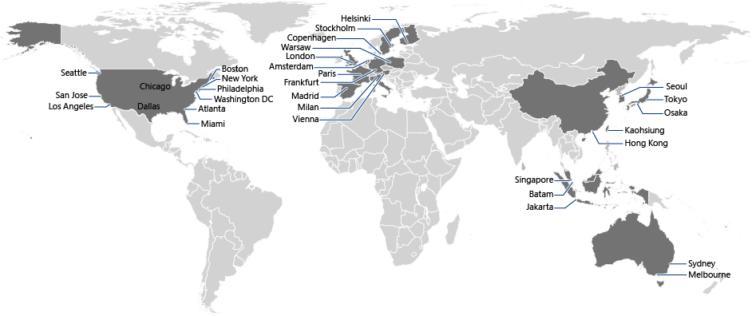
Current Azure CDN Point of Presence [POP]

Slide 13
Demo CDN
Show and explain Azure Search in the portal. Demo creation process.
(if time permits, show the demo setup of search).

Slide 14



CreateThumbnail
Send
Trigger
Update Search Index
PublishToCDN
[Message] NewImageAdded
[Queue] newimageadded
[WebJob]
MessageBus
[WebJob]
Dispatcher
[WebJob]
Handlers

Slide 15
Demo of background tasks:
Show the webjob
Explain the dispatcher
Show the newimagemessage queue
Implement the Ihandle<> for thumbnail generation
Implement the Ihandle<> for new search document
Demo upload of image
Go back to api and explain how it could be used there

Slide 17

Storage
Metadata
Medi Services

Slide 18
Demo of media servics
Explain where it get’s stored
Show storage command
Explain how to create streaming endpoints
Implement handler
Explain jobs and tasks
Show jobs and tasks in portal
Use the dash reference portal

Slide 19

Media Player

Slide 20
Demo Azure media player
Show the site where you can test
Implement the mavi handler
Emphesize jobs and tasks
Show mavi result file for keywords

Slide 21

Media Intelligence

Slide 22
Demo of media servics
Show MAVI website and explain the concept
Implement the mavi handler
Emphesize jobs and tasks
Show mavi result file for keywords

Slide 24
Microsoft Azure Tour Stockholm
18:e November 2015
Stockholm City Conference Center
http://aka.ms/azuretourstockholm

Slide 26
Digital Asset Management i Azure
Patrik Löwendahl
CTiO - Avanade

